Slide 1
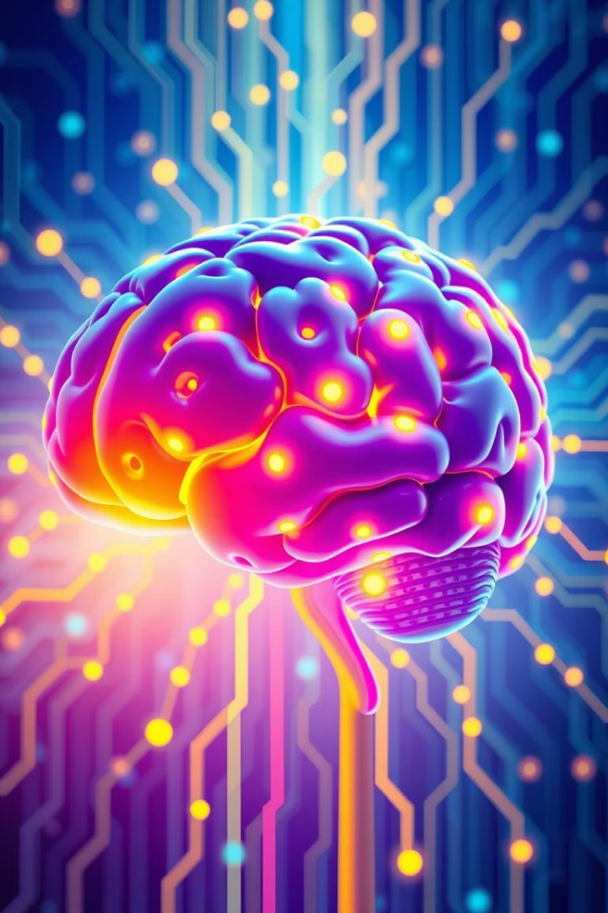
Generative AI: From Machine Learning to RAG Chatbots
Presented by: Tharindu Dhanushka

Slide 2
Agenda
1
ML Concepts & Foundations
Review core machine learning principles.
2
Evolution to Deep Learning & Transformers
Explore the progression to advanced AI.
3
Transformer Architecture & GPT-2
Detailed look at key architectural components.
4
Generative AI & Chatbots
Understand how new content is created.
5
Retrieval-Augmented Generation (RAG)
Discover how external knowledge is integrated.
6
Summary & Q&A
Key takeaways and open discussion.

Slide 3
Machine Learning Basics
Supervised Learning
Unsupervised Learning
Model Pitfalls
Uses labeled data for predictions.
Finds patterns in unlabeled data.
Common issues in model performance.
Classification
Clustering
Regression
Dimensionality Reduction
Overfitting: Train well, test poor
Underfitting: Fails to capture patterns

Slide 4
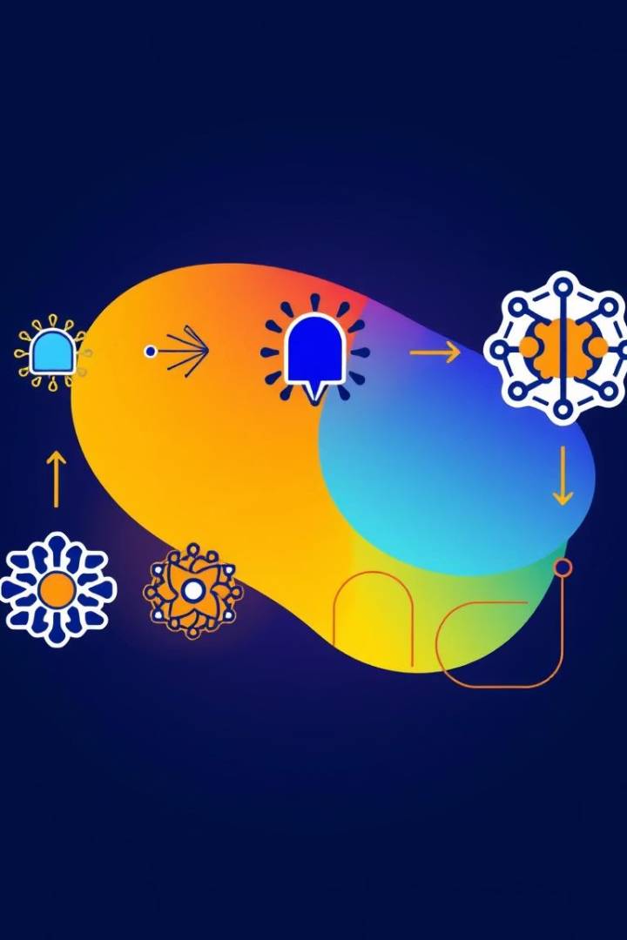




From ML to Generative AI
Machine Learning
Basic algorithms, statistical models
Artificial Intelligence
Broader field of intelligent agents
Deep Learning
Neural networks for feature learning
Generative AI
Creates new, realistic content

Slide 5
RNN vs. Transformer
Recurrent Neural Networks (RNN)
Transformer
Processes data sequentially.
Processes data in parallel.
Good for sequences
Self-attention mechanism
Long-term dependency issues
Better performance and scalability

Slide 6
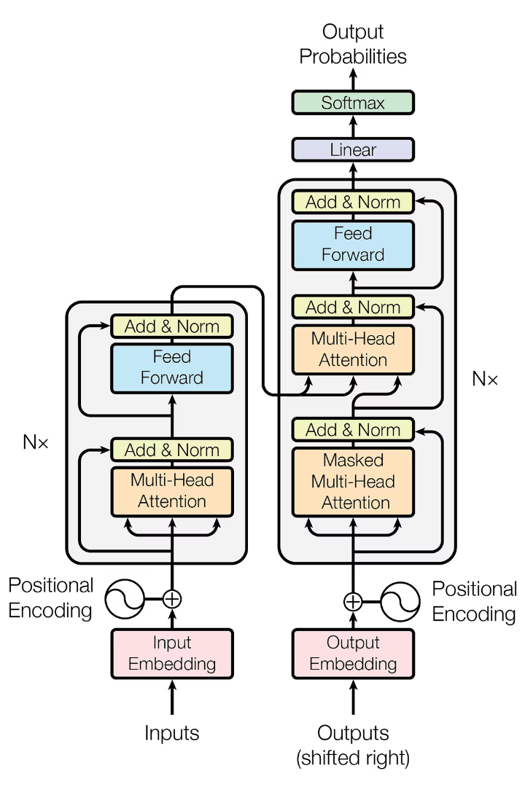
Transformer Architecture
Input Encoding
Tokens converted to Query, Key, Value vectors.
Self-Attention
Computes relevance (QKᵀ) and weighted sum.
Feedforward Network
Position-wise fully connected layers.
Layer Normalization
Stabilizes training process.

Slide 7





GPT-2: Deep Dive
Input Embedding
Tokens map to dense vectors.
Positional Encoding
Adds word order information.
Attention Layers
QKᵀ / √d computes attention.
Normalization & MLP
LayerNorm and Feedforward layers.
Output Layer
Softmax predicts next token.

Slide 8
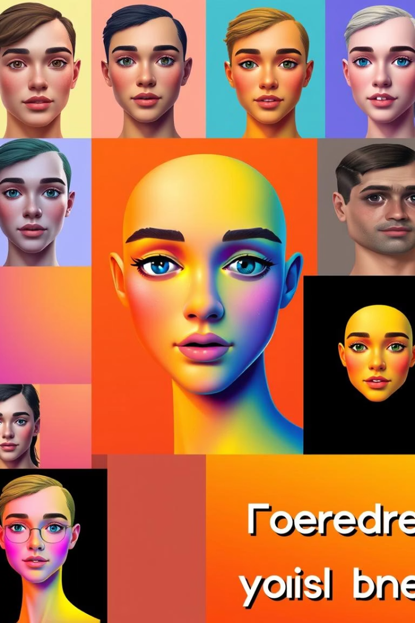
What is Generative AI?
New Data Creation
Key Examples
Generative AI creates new content based on learned patterns.
ChatGPT: Text generation
DALL·E: Image creation
Copilot: Code generation
Core Technologies
Powered by Large Language Models (LLMs) and Transformer networks.

Slide 9








LLM Chatbot Implementation
System Prompt
User Query
Defines model's persona and behavior.
User inputs their question or command.
Context History
Model Response
Internal token history maintains conversation flow.
LLM generates context-aware answer.

Slide 10
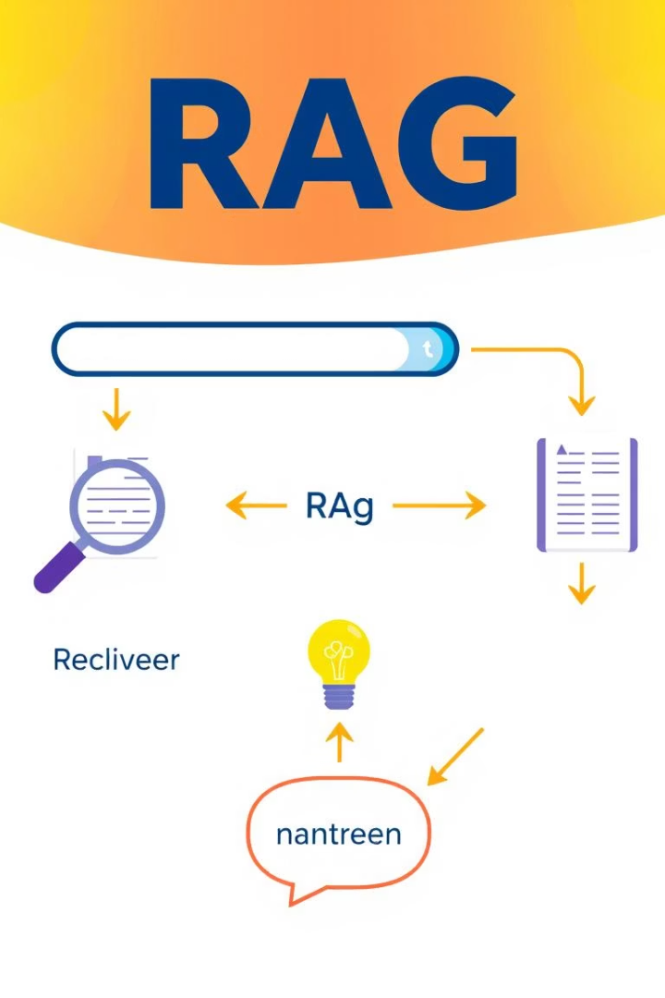




RAG: Retrieval-Augmented Generation
Combines Retrieval
Augments Generation
External Knowledge
Information retrieved from external knowledge base.
LLM generates response using retrieved data.
Accesses information beyond training data.
Improves Accuracy
Enhances factuality and relevance of answers.

